Slide 1
Psychososial assistance
Oslo emergency agency
Sexual assault
Domestic violence
Protective Services for the elderly
Anne Berit Lunde, senior advisor
Gyri Scheie, senior advisor

Slide 2
How to eat an elephant – one bite each day
The womens movement in the -70thies loudly adressed issues concerning domestic violence and sexual abuse.
Public opinion at the time saw theese issues to be privat and personal.
40 years ago in 1976 the first shelter for abused women was established in Oslo.
30 years ago the first sexual assault sencet vas established in Oslo.
20 years the authorities saw the need to establish a special focus on the abuse of the elderly.
These issues are now considered a responsibility for society as a whole

Slide 3
Oslo emergency agency
Same location last 110 years
A place to turn to for almost all emergencies:
      Acute disease
      Intoxication
      Minor surgery
      Psychiatry
      Acute social need – both material and psychosocial
      Multi/cross professional

Slide 4
Psychososial assistance
Oslo emergency agency
Free of charge
Open 24/7
Low threshold
Integrated in other services, most staff have also other tasks
Special training program 1-2 days for doctors, nurses and social consultants
Main focus on sexual assault/domestic violence in the acute/subacute phase

Slide 5
Organisation
Sexual assault/domestic violence is a priority in all departments at the emergency agency – this means:
Minimal time to wait for consultation after arrival
All staff have a focus on possible underlying assault in other types of medical emergencies – as f.eks intoxications or physical injuries
First consultation and follow-up program is organised of doctors, nurses and social-consultants.

Slide 6
Guidelines
The patients get help independent of police service
The patients own their information and it is only released to the police on the patients request
Everyone is entitled to get the same type of help
There is no demand on patients to report to the police
The patients are free to choose only a part of the service

Slide 7
Definitions
Rape:
”Penetration in vagina or anus by penis, object or finger, done
by force, threats, manipulations or intoxications”
Domestic violence:
”Physical or/and emotional abuse are behaviour used by one person in a relationship to control the other person”
On elder abuse:
”A single or repeated act or lack of appropriate action, occurring within any relationship where there is an expectation of trust, which causes harm or distress to an older person”. WHO

Slide 8
Sexual assault and domestic violence
A never ending story
Building understanding
Consequences both for the individual as well as society
Prevalent
Criminal
A risk to health
      Physically
      Mentally
      Socially
Embedded in myths and stereotypes
Underreported: 10-20% contact the police/health service
Underdocumented: from health services to the police
Prospects of convitions are low

Slide 9
Consequenses for the individual
Psychological:
”Trauma is poison to the brain”
    PTSD, severe anxiety, depression, suicide risk, addiction problems, Risk behaviour/re-victimisation, self-esteem, self-coping
Social:
    Saftey, Education/work, Housing/living, Stigmatisation, Social relations, direct/indirect effects on children and family.
Somatic:
    Pregnancy, sexually transmitted diseases, sequelas from physical injuries, chronic pain, immunity/stress disease, higher risk for early death.

Slide 10
Consequences for society
Sexual assault and domestic violence
is a public health issue!
Health cost
Social costs
Legal costs
Violence generates violence: future generations, both on community level as well as on individual level

Slide 11
First consultation
Psychosocial emergency assistance
Symptoms of trauma:
Fear and anger
Anxiety
Shock and loss of control
Cognitive breakdown an chaos
Shame, guilt and selfloathing
Breakdown in trust and withdrawel
Sense of de-realisation - “I can’t believe this has happened”

Slide 12
First consultation
Psychosocial emergency assistance
The trauma episode – non emotional
Information about the services and follow-up program – new appointment within a week!
Counselling/Emotional first aid, and information about normal post-traumatic reactions.
Mapping ( including previous trauma, risk factors) the patients mental/emotional condition
Focus on safety issues and the importance of mobilize the patients network, as well as school, work, duties.

Slide 13
First consultation
Psychosocial emergency assistance
Measures:
Establish a shielded and safe environmentand help the patient regain control and hope!
Give acceptance and build an alliance with the patient – never question the pasients story!
Always talk with the patient alone
If possible – offer family/accomanying person counselling from a college.
Do not reinforce the emotions connected with the trauma – and give advice to wait 6-8 hours before going to bed – because imidiate sleep will reenforce the trauma!

Slide 14
First consultation
Psychosocial emergency assistance
Symptoms Measures
Fear, anxiety, shock, insecurity Shielding – a calm and safe surrounding, safety
Loss of control, chaos and Stabilisation, caregiving
Cognitive breakdown
Shame, guilt, self-loathing Show respect, place guilt
Anger Reflection, confirm justification for anger
Broken trust/withdrawal Build alliance
Sense of denial/disbelief Review the incident – briefly!

Slide 15
First consultation
Psychososial emergency assistance
Safety
preparing the patient
The perpetrator may resort to both treats and ”golden promises”.
Make a safety plan – with concrete measures: no contact on phone or social media, safe place to stay, alarm, restraining order, replacing lock, involve close network for help and protection
In cases concerning domestic violence – safety is crucial! Its not unusual for patients to underestimate the level of danger!
Confirm the ambivalence within the patient – the person she/he loves also represent danger.

Slide 16
Rehabilitation – four dimensions
Judicial: forensic medical examination, supportive lawyer, police, court, compensatory justice.
Medical: injuries, sequels, pregnancy, STD, follow-up, sick leave, re-education
Psychological: acute counselling, crisis support, and a psychososial follow-up program, counselling to family members
Social: safety, a place to live, income, child welfare

Slide 17
Psychososial follow up
Psychososial follow-up sessions with a counsellor: A counselling program developed in The Sexual assault center based on established knowledge about trauma and normal reactions after dramatic events
Medical follow-up and sessions with a Doctor: Suicide evaluation, vaccinations w.m.
Further referrals if needed
Open door policy

Slide 18
Psychososial follow up
Help to obtain legal counsel
Set an appointment within a week
SMS reminder of appointment the day before
6 – 8 conversations with a counsellor over 3 – 4 months. Individual conversations
Systematic checking and contact if failure to appear
Offer of counselling for people close to the client

Slide 19
Psychososial follow up
Structured consultations – help to stabilize first weeks/months after the assault
Provide knowledge on trauma reactions
How to take care of one selves: structuring everyday-life, coping with anxiety, not to isolate from others, concentration issues, eating-habits, sleeping patterns, invasive memories w.m
Explore factors preventing a realization/enjoyment and mastering of one’s life
Understanding of/knowledge about psychologically normal reactions and typical social problems that arise
Emphasize emotions, reactions behavior and interaction with environment

Slide 20
Psychososial follow up
It is important that we actively share knowledge about trauma with the victim of assault
Why:
Gives a sense of control
Knowledge reduces anxiety and gives more predictability
Strengthens the victim’s ability to expect the unexpected – protection
Prevents chronic disorders
How:
By normalising and generalising
By recognising and confirming the unique
By actively using clinical judgement – understand what is needed to reach the victim of assault
Knowledge about reactions to trauma quality assures the programme for the victim of abuse

Slide 21
Psychososial follow up
Overview of follow-up topics:
Anxiety The abuser
Safety Reporting to the police
Mastering day-to-day life Post-traumatic reactions
Guilt and responsibility Feeling of shame
Withdrawal and isolation Intrusive images
Concentration problems Relationships
Sexuality Existential issues
Notes:
Safety: The abuser may resort to threats or use friends to threat or exert pressure if the case is reported to the police
Help to get the police and legal counsel involved in such situations
In cases concerning violence in close relationships safety is crucial. Where violence has taken place over an extended period of time the patient may have an unrealistic view of the danger. You have to work on this!
Concrete proposals and measures are necessary (shelter, alarm, restraining order, stay with friends, replacing locks, network to help and protect). Ambivalence – the person she loves also represents a threat!
Reporting to the police: The patient will often need time to decide what to do. The counsellor may be an important partner to talk with. The counsellor may help to highlight the consequences of various options. Give advice for the meeting with the legal counsel
Mastering daily life: Conversation and counselling on how to plan, facilitate and change so daily life can be more tolerable and manageable
Food and sleep – the primary needs must be taken seriously! Cooperate with the doctor. Be restrictive with sleeping medication the first days
Structure in daily life
Regularity, maintain day and night rhythms
Activities that might offer relief
Information Post-traumatic reactions: Important because this reduces the burden of experiencing reactions one does not understand or misinterprets. “There’s something wrong with me”
Guilt and responsibility: Help the patient to distinguish between their own responsibility and the other’s guilt
Anyone who is the victim of assault knows they are responsible for some choices prior to the abuse and are concerned about these choices
Many see their choices as equal to the subsequent abuse (e.g. the road taken, drinking too much)
We must examine these choices together, what motivated them – what did she think. Break down the idea that these choices had a direct link to and caused the assault
How far into the incident did the patient have freedom of choice?
Victims of abuse tend to assume guilt even for things they were unaware of at the time of the assault. They have then used this information later on to blame themselves
Talk about what type of information one had during the situation and which information has come after the fact. This may help to alleviate the burden of guilt
Feeling of shame: A feeling of shame may impact relationships, prevent realisation/enjoyment of life and reduce the quality of life. It may also dominate one's self-esteem and will often reinforce withdrawal and isolation. What does it do to me to be a “rape victim”?
It may be necessary to inquire about these feelings, to bring them out by supplying new knowledge and understanding. Take control and place the shame!
Withdrawal and isolation tendencies: Levels of isolation and withdrawal are considered normal initially and also have logical connections to feelings of guilt and shame
The consequence may be that the patient does not receive the necessary help, whether from networks or the assistance system. Extra alertness is therefore vital to prevent withdrawal
Intrusive images and recollections: These are normal post-traumatic reactions for some time after the assault. These are painful and aggravating reactions which erode concentration and mastering of daily life. We always ask about this! One cannot expect that the patient will always want to address this. There are self-help exercises that have proved to be quite effective! The screen technique. Clouds drifting away.
Concentration problems: Information that this is a common post-traumatic reaction is important. A loss of the ability to concentrate causes problems in school and work situations. Suitable measures may be information letters to the school or employer. Reduce the workload for a period. Teaching adapted to the situation and the reduction in learning capacity
Relationships:The patient's perceptions of network reactions are very important in the follow-up activities. Many need time to decide whether they want to inform the people closest to them. Perhaps some should avoid doing so. If the patient has a network that can contribute, it may be important that it uses the counselling program. A supportive network may have a healing effect. Mobilizing networks is thus very important when working with victims of abuse. A network that rejects and accuses the victim of abuse reinforces the trauma. Research shows that lack of support or rejection and accusations are factors predicting serious mental problems in the time after the abuse
Sexuality: Abuse has consequences for intimacy and sexuality. Some react by wanting to distance themselves from their partner for a period of time. Others seek the opposite and have a greater need for intimacy. It is important that she/he feels safe and has control in the situation.
Existential issues: When one’s existence and who one is are threatened, the patient (primarily adults) will often fixate on existential questions – such as what is the meaning of my life, is there a God when such things happen, was it fate, was there a meaning in this happening to me, what can I do with my life?
As counsellors we must be willing to take part in the patient’s thinking on these difficult issues, which are often very pressing questions for the patient, and where putting things into words may ease and clarify the situation

Slide 22
Psychososial follow up
Anxiety
"Window of tolerance"
The place where you feel safe and comfortable
After a trauma:
Your window of tolerance shrinks

Slide 23
Psychososial follow up
Anxiety is normal – and in many cases your best friend!
Anxiety is painful reaction to a traumatic incident.
Most patients need some education on the topic in order to be able to help themselves.
The cognitive triangle: the more you believe your thought is truthful – the stronger the emotion – which directs your actions.

Slide 24
Psychososial follow up
Learn the symptoms:
Physiological reactions: shallow breathing, palpitation/chest pain, cold sweat, tingling sensations in the fingers, rise in blood pressure
Disaster thoughts will trigger and reinforce anxiety:
Someone will hurt me
I will faint
I will die from a heart attack
I will get a panic attack
The perpetrator will return

Slide 25
Psychososial follow up
Anxiety
How to help yourself:
Breathing exercise: "The paint brush"
Adjusting disaster thoughts
Exposure – "Get back up on the horse"
Homework

Slide 26
Psychososial follow up
Monitoring anxiety:
Do the patient avoid situations that trigger anxiety?
Scaling panic-attacks from a scale of 0-10
Challenge the patients truth/belief in disaster thoughts
Put together a anxiety-hierarchy – graded from lesser up to the most scary activities, and start with the lesser scary exposure exercises.

Slide 27
Psychososial follow up
Proactive approach
Since 2008, our staff have worked systematically with improving the content of the follow-up programme.
Proactive approach towards all pasients if they fall out of the programme.
There is a continious emphasis on establishing good relations between staff and patients.
In 2008 30-40% of all pasients underwent the programme.
In 2015 70% of all pasients underwent the programme.
The pasients reports that they appreciate this proactive approach.

Slide 28

Domestic violence

Slide 29
Abuse has no age limit
Based on international research and local clinical experience we estimate that 4 – 6 per cent of the elderly population (+65 years of age) in Norway has been exposed to abuse each year
WHO 2008, NKVTS 2007
Notes:
Norwegian Centre for
Violence and Traumatic Stress Studies, NKVTS
Appx. 620 000 inhabitants
In Oslo there are 88 926 persons above 62 years of age (Statistics Norway 2010)
Appx. 5000 persons above the age of 62 are exposed to some form of abuse each year

Slide 30

What is elder abuse
Physical
Emotional
Financial/material
Sexual
Neglect (WHO 2002)
Notes:
30
30
30
“Elder abuse is a single or repeated act, or lack of
appropriate action, occurring within any relationship
where there is an expectation of trust which causes harm
or distress to an older person.” (WHO 2002)
The City of Oslo established the Protective Services for the Elderly in 2000
Abusive actions can be pysical, psychological/emotional, financial/material and sexual, and also include intentional and unintentional neglect.
PHYSICAL ABUSE – Use of physical force that may result in bodily injury, physical pain or impairment.
PSYCHOLOGICAL OR EMOTIONAL ABUSE– Infliction of anguish, pain or distress through verbal or non-verbal acts.
SEXUAL ABUSE – Non consensual sexual contact of any kind.
FINANCIAL AND MATERIEL ABUSE – Illegal or improper use of an elder’s funds, property or assets.
NEGLECT – Refusal, or failure, to fulfil any part of a person’s obligations or duties towards an elderly person.
Domestic violence often occurs in the hidden, the violence is repetitive and the abuser/offender is often a person the older person has a emotional relation to, often which the offender is, and the threshold for reporting is high.
Latent Violence, the risk of new violence may/will control the life of the abused person completely.
Seniors can be a vulnerable group due to illness, other age-related conditions and fewer social arenas (friends and other networks will be gone)

Slide 31
Barriers within the public services
Society’s attitudes towards elderly and abuse
Lack of knowledge and qualifications
Jonassen and Sandmoe, 2012
Management and care culture
Sandmoe, 2011
Notes:
Recent research in Norway reveals these barriers:
1. Society
2. Lack of knowledge and qualifications within the public services
3. The need of a culture and management where elder abuse is being communicated and taken care of
31

Slide 32
Challenges
”You won’t see it until you believe it”
Identify abuse
Make the Protective Services for the Elderly known to the public
Notes:
From our experience, it seems still hard to believe that elderly are being exposed to abuse.
There is a need for increased awareness of elder abuse in society – and this will require financial priorities – both nationally and minicipally
Our challenge – our hope.

Slide 33
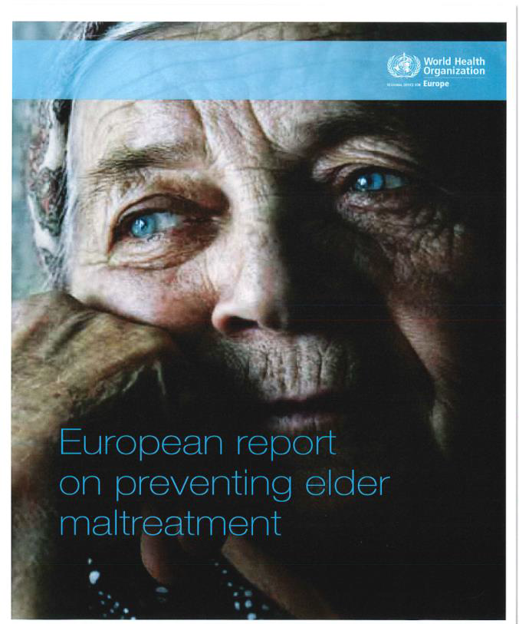

References
Notes:
NKVTS, Norwegian Center on Violence and Traumatic Stress, study 1/2014
5 % utsatt for grov vold/partnervold (8% kvinner, 2 % menn)
10 % barn vitne til vold mellom foreldre
Bare 10% oppsøker medisinsk hjelp i tiden etter volden
1 av 3 kvinner og 1 av 6 menn har aldri fortalt noen om volden
Gjennomsnittlig blir 1 kvinne drept månedlig i Norge
Kostnadsanalyse 4,6 til 6,0 milliarder årlig
WHO 2014
This report focuses on interpersonal violence, which is violence that occurs between family members, intimate partners, friends, acquaintances and strangers, and includes
child maltreatment, youth violence, intimate partner violence, sexual violence and elder abuse. Interpersonal violence is a risk factor for lifelong health and social problems. It is
both predictable and preventable, and responsibility for addressing it rests clearly with national governments.
http://www.who.int

